Slide 1
KeyStone Multicore Software Development Ecosystem

Slide 2
Agenda
Multicore Development Ecosystem
Code Composer Studio (CCS)
Multicore Software Development Kit (MCSDK)
Third Party Software
C66x Lite Evaluation Module (EVM)

Slide 3
Software System Basics
Utilizing system hardware peripherals
Low level drivers (LLD) to abstract communication with the hardware layer, including device-specific modules/interfaces (from one or more manufacturers)
One or more layers of utility APIs (routines, structures, variables, etc.) that connect the application to the LLD
Running applications
Management, scheduling, and prioritization of threads
Managing memory, processors, and input/output devices
Standard API for utilities:
Print
Networking (sockets)
Monitoring
Application development ecosystem:
Integrated Development Environment (IDE) tools:
Source code editing
Build automation
Debugging
Libraries (code, sub-routines, values, etc.)

Slide 4
TI DSP Software Support
SYS/BIOS (formerly DSP/BIOS) Real-time Operating System (RTOS) support for DSP-only and DSP+ARM devices, including:
Scheduling (hardware/software interrupts, tasks)
Memory management
Communications
Performance monitoring
Optimized algorithm libraries
Framework components
Easy access to peripherals and other resources (DMA)
Abstracts hardware from the application (CSL)
IDE for single core and multicore devices
Code Composer Studio (CCS)
Code Generation (CodeGen)
Debug, emulation, monitoring, profiling

Slide 5
KeyStone Advantages & Requirements
KeyStone SoC devices offer many advantages:
Multiple cores
Advanced core performance
Distributed memory architecture
Multiple peripherals and co-processors
High-speed transport mechanisms
Challenge: How to simplify programming and development of optimized applications on KeyStone devices?
Solution: A fully integrated software development ecosystem built upon the Multicore Software Development Kit (MCSDK)

Slide 6
TI Software Development Ecosystem Multicore Performance, Single-core Simplicity
Eclipse IDE
Multicore Software
Development Kit
(MCSDK)
Code
Composer
StudioTM
Third
Party
Plug-Ins
Host Computer
Target Board
Emulator

Slide 7
TI Software Development Ecosystem Code Composer Studio + Eclipse IDE
Eclipse IDE
Multicore Software
Development Kit
(MCSDK)
Code
Composer
StudioTM
Third
Party
Plug-Ins
Host Computer
Target Board
Emulator

Slide 8
Code Composer Studio (CCS)
Code Composer Studio (CCS) is an Eclipse-based IDE that supports application development on multiple cores/devices:
GUI interface for SYS/BIOS, project-based system to build drivers and utilities for developer’s target platform.
Multiple perspectives (default and custom)
Advance debugging, monitoring, and profiling
Multiple configurations allow a single executable or multiple executables to be generated for the same project.
Editor
Integrated compiler tools
Support for OpenMP
Simulator
Debug/Emulation
Remote Debug
Instrumentation
Visualization

Slide 9
TI Software Development Ecosystem Multicore Software Development Kit
Eclipse IDE
Code
Composer
StudioTM
Editor
Compiler Tools
Multicore Software
Development Kit
(MCSDK)
Third
Party
Plug-Ins
Simulator
Debug/Emulation
Remote Debug
Instrumentation
Visualization
Host Computer
Target Board
Emulator

Slide 10
MCSDK Overview
Standard set of APIs to configure and utilize peripherals, accelerators, and other hardware resources
Compliant implementation of packet- and network-based protocols
Utilities to boot, test, debug, and monitor execution
Individual core-based real-time operating system
Communication and facilitated cooperation between processes, cores, and devices, as well as between peripherals and cores
Optimized, ready-to-use algorithm libraries, example code, and demonstration applications

Slide 11
MCSDK Advantages
Provides the core foundational building blocks for customers to quickly start developing embedded applications on TI high-performance multicore DSPs:
Uses either the SYS/BIOS or Linux real-time operating system
Accelerates time-to-market by focusing on ease of use and performance
Provides multicore programming methodologies and utilities
Simplifies porting of applications:
To a standard evaluation platform
From a standard evaluation platform to customer’s target platform
To next generation platform hardware
Available as a free download on TI.com, bundled in one installer as source code along with pre-built libraries

Slide 12
BIOS-MCSDK Software Layers
Demonstration Applications
HUA/OOB
IO Bmarks
Image
Processing
Software Framework Components
Communication Protocols
SYS/BIOS
RTOS
Inter-Processor
Communication (IPC)
Instrumentation
(MCSA)
TCP/IP
Networking
(NDK)
Algorithm Libraries
Platform/EVM Software
DSPLIB
IMGLIB
MATHLIB
Platform
Library
Transports - IPC - NDK
Low-Level Drivers (LLDs)
Resource
Manager
Power On Self
Test (POST)
EDMA3
PA
SRIO
FFTC
TSIP
OS
Abstraction Layer
Bootloader
PCIe
QMSS
CPPI
HyperLink
…
Chip Support Library (CSL)
Hardware

Slide 13
Development Requirements > MCSDK Solutions
Development Requirement | MCSDK Solution
Hide hardware details from the user to simplify process of porting to new hardware. | Chip Support Library (CSL) is the only MCSDK layer that depends on the hardware. This layer is completely transparent to the user/application.
Standard API to talk to peripherals, accelerators, and other resources | Low Level Drivers (LLD) provide standard API to initialize, configure, and utilize peripherals and other resources. LLD blocks include SRIO, PCIe, PA, CPPI, QMSS, FFTC, and many more.
Utilities to facilitate system operations | Platform/EVM Software provides platform-level utilities such as bootloader, Power On Self Test (POST), resource manager, and platform utilities.
Efficient real-time individual core operating system | SYS/BIOS provides an efficient, mature, real-time operating system with a low memory footprint.
Reliable interface to external networks | Network Development Kit (NDK) provides a standardized interface for common packet- and network-based communication protocols (e.g., IPV4 and IPV6-compliant TCP/IP).
Coordination of tasks/process across multiple cores | Inter-Processor Communication (IPC) provides several-high level utilities and libraries to communicate between cores and enable multiple cores to work together.
Facilitate application development | Optimized algorithm libraries with standard APIs.
A starting point for multicore application development | Demonstration applications (e.g., Image Processing) show how to build and run a complete multicore application.

Slide 14
Communication via LLD and CSL Layers

Slide 15
MCSDK Algorithm Libraries
Algorithm libraries contain C66x C-callable, hand-coded, assembly-optimized functions for specific usage:
DSPLIB provides signal-processing math and vector functions:
Adaptive filtering
Correlation
FFT (e.g. FFT functions for ‘npoint’ FFTs)
Filtering and Convolution (e.g., FIR, IIR filter functions, etc.)
Matrix (e.g., single and double precision matrix multiplication, etc.)
IMGLIB provides image/video processing functions:
Compression & Decompression (e.g., forward and inverse DCT, motion estimation, quantization, etc.)
Image Analysis (e.g., edge detection, histogram, thresholding, etc.)
Image Filtering and Conversion (e.g., color space conversion, convolution, correlation, error diffusion, etc.)
MathLIB provides floating-point math functions:
Single-precision (e.g., cosine/sine/tangent of a floating point number, etc.)
Double precision (e.g., similar functions as above with argument type and return values to be of type double)
More info: http://processors.wiki.ti.com/index.php/Software_libraries

Slide 16
Inter-Processor Communication (IPC) Usage
IPC provides a standard interface between processes/threads in the same core, between two cores, and between two devices.
Device 1
Device 2
IPC Transports | Task to Task | Core to Core | Device to Device
Shared Memory | x | x
Navigator/QMSS | x | x
Serial Rapid IO (SRIO) | x | x | x
Core 1
Core 2
Core 1
Core 2
BIOS
Process 1
Process 2
BIOS
Process 1
Process 2
BIOS
Process 1
Process 2
BIOS
Process 1
Process 2
IPC
IPC
IPC
IPC
SoC Hardware and Peripherals
SoC Hardware and Peripherals
Device 1
Core 1
Core 2
Core 3
Core N
Linux
Process 1
Process 2
BIOS
Process 1
Process 2
BIOS
Process 1
Process 2
BIOS
Process 1
Process 2
SysLink
IPC
IPC
IPC
SoC Hardware and Peripherals

Slide 17

Simplified Development & Migration
TI Demo Application on TI Evaluation Platform
TI Demo Application on Customer Platform
Customer Application on Customer Platform
Customer App on Next Generation TI SOC Platform
Demo Application
Demo Application
Customer Application
Customer Application
Tools
LIB
Tools
LIB
Tools
LIB
Tools
LIB
Network
Dev Kit
(NDK)
Network
Dev Kit
(NDK)
Network
Dev Kit
(NDK)
Network
Dev Kit
(NDK)
LLD
IPC
TI Platform
LLD
IPC
Customer Platform
LLD
IPC
Customer Platform
LLD
IPC
Next Gen TI SoC Platform
CSL
CSL
CSL
CSL
Software may be different, but API remain the same (CSL, LLD, etc.)
No modifications required
May be used “as is” or customer can implement value-add modifications
Needs to be modified or replaced with customer version

Slide 18
MCSDK Top-level Directory Folders
/mcsdk
/pdk
/edma3
/bios
/dsplib
/imglib
/mathlib
/ipc
/ndk

Slide 19
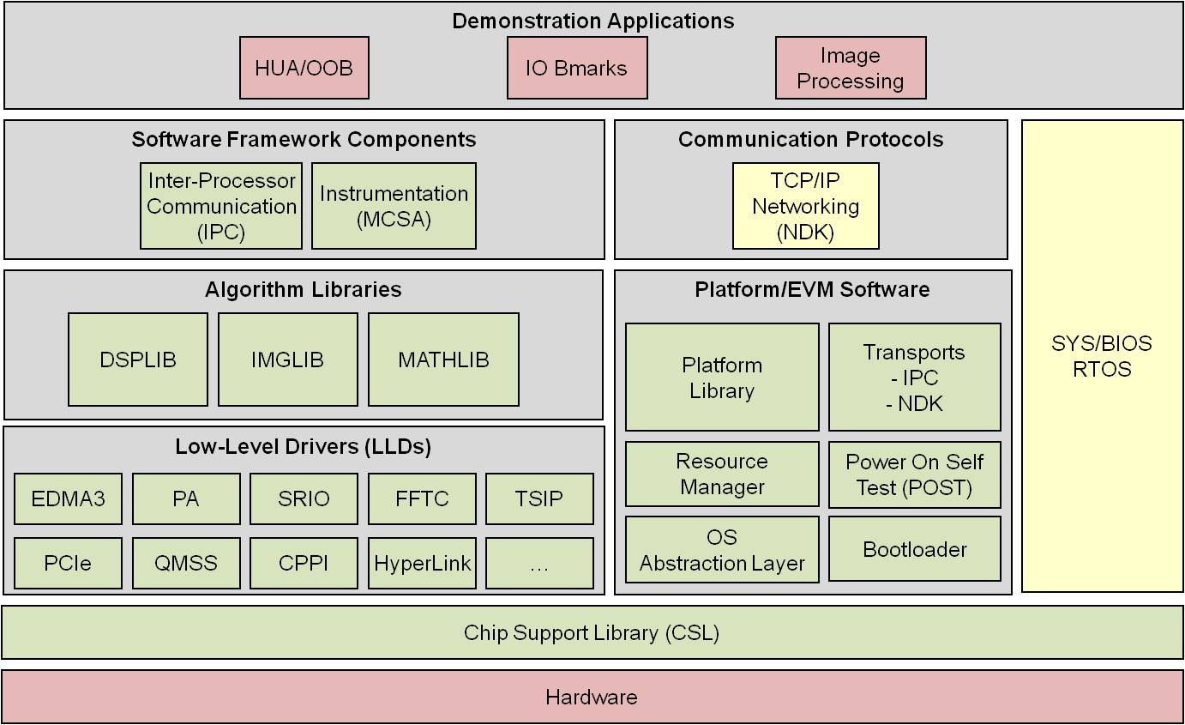
TI Software Development Ecosystem Third Party Software Plug-ins
Eclipse IDE
Multicore Software
Development Kit
(MCSDK)
Code
Composer
StudioTM
Editor
Compiler Tools
Third
Party
Plug-Ins
Simulator
Debug/Emulation
Remote Debug
Instrumentation
Visualization
Host Computer
Target Board
Emulator

Slide 20
Third Party Plug-Ins
Eclipse allows developers to integrate third-party software tools that provide additional multicore programming, profiling and analysis capabilities:
Poly-Platform from PolyCore http://polycoresoftware.com is a development framework consisting of tools and run-time software that provide a programming model for applications to scale from one to many cores.
Prism from CriticalBlue http://www.criticalblue.com provides multicore analysis and exploration tools to evaluate parallelization strategies of existing software applications.
Optima from ENEA http://www.enea.com includes overview and management tools for multicore systems, profiling tools showing resource usage, and debug tools that track execution of application and operating system events.
Diamond from 3L http://www.3l.com is a tool-suite and model that provides a highly automated development flow from concept through to applications running in multiprocessor hardware.

Slide 21
TI Software Development Ecosystem Multicore Performance, Single-core Simplicity
Eclipse IDE
Multicore Software
Development Kit
(MCSDK)
Code
Composer
StudioTM
Third
Party
Plug-Ins
Editor
PolyCore
Compiler Tools
Critical
Blue
Simulator
ENEA
Optima
Debug/Emulation
3L
Remote Debug
Instrumentation
Visualization
Host Computer
Target Board
Emulator

Slide 22
Linux/BIOS MCSDK C66x Lite EVM Details
DVD Contents
EVM Flash Contents
EEPROM
128 KB
NOR
16 MB
NAND
64 MB
Factory default recovery
EEPROM: POST, IBL
NOR: BIOS MCSDK Demo
NAND: Linux MCSDK Demo
EEPROM/Flash writers
CCS 5.0
IDE
C667x EVM GEL/XML files
BIOS MCSDK 2.0
Source/binary packages
Linux MCSDK 2.0
Source/binary packages
POST
BIOS MCSDK
“Out of Box” Demo
Linux MCSDK
Demo
IBL
Online Collateral
TMS320C667x processor website http://focus.ti.com/docs/prod/folders/print/tms320c6678.html http://focus.ti.com/docs/prod/folders/print/tms320c6670.html
MCSDK website for updates http://focus.ti.com/docs/toolsw/folders/print/bioslinuxmcsdk.html
CCS v5 http://processors.wiki.ti.com/index.php/Category:Code_Composer_Studio_v5
Developer’s website Linux: http://linux-c6x.org/
BIOS: http://processors.wiki.ti.com/index.php/BIOS_MCSDK_2.0_User_Guide
Notes:
22

Slide 23
For More Information
MCSDK Product Folder: http://www.ti.com/tool/bioslinuxmcsdk
Download CCSv5 and MCSDK software: http://software-dl.ti.com/sdoemb/sdoemb_public_sw/bios_mcsdk/latest/index_FDS.html
KeyStone C66x Multicore Wiki Resources http://processors.wiki.ti.com/index.php/Keystone_Device_Architecture
For questions regarding topics covered in this training, visit the support forums at the TI E2E Community website http://e2e.ti.com

